Slide 1

The project
Application description
Application testing and bug discovering

Slide 2
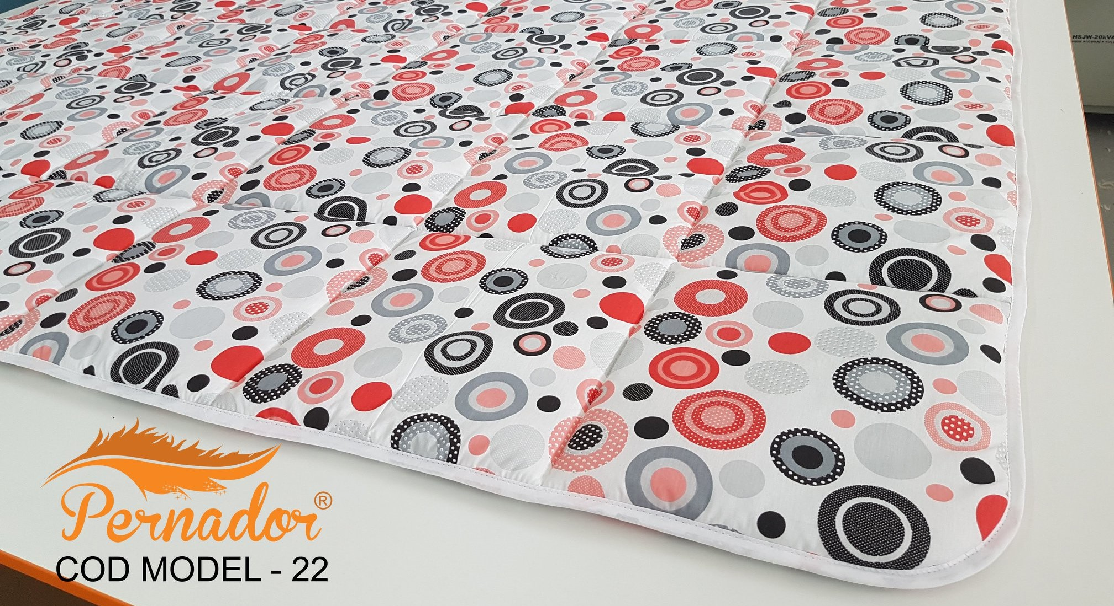
www.pernador.ro
Pernador is a pillows, duvets, bed sheets and other textile products producer. They state that they are different by their creativity and quality of their product. The company is based in Iasi, and their products are 100% purely Romanian.
Their website allows people to see and buy their products in an easy-using environment, also having the option of making orders from WhatsApp and Facebook.

Slide 3

Testing activities
Registration form – Functional testing
Shopping cart – Functional testing
The first 2 were done through manual testing.
The next 2 were done through exploratory testing.
Promotions
Search bar

Slide 4

Test cases
There were a total of 50 Test Cases.
The first feature which had 40 Test Cases and a success rate of 70%,being the Registration form.
Whereas the second feature, the Shopping cart with only 10 Test Cases, had a 80% success rate.

Slide 5

Bugs overview
I have listed 3 bugs found:
1.Metraje section not working properly, when clicking on the button nothing happens.
2.YouTube hyperlink button not functioning properly, the link redirected to contains an error displaying the message : "404 Not Found"
3.Image from the "Pilote" section not loaded properly.

Slide 6

The conclusion
Pernador is a very useful application which can of course, like any other app, be improved. It has a lot of flaws, that can thankfully be solved easily with some better requirements and a little more work from the team that is responsible for this website.
A lot of test cases have failed, and also while exploratory testing some big issues were found.
On the other side, not a lot of bugs have been found.

Slide 7
Lessons learnt
- Testing is not as easy as people think, it also takes time and a lot of creativity.
-Working on homework and with the other students while in the class really improves your knowledge about working together as a team.

